Slide 1
Probabilistic Programming
Marius Popescu
popescunmarius@gmail.com
2019 - 2020

Slide 2
Project 1
Topic Modeling in PyMC

Slide 3
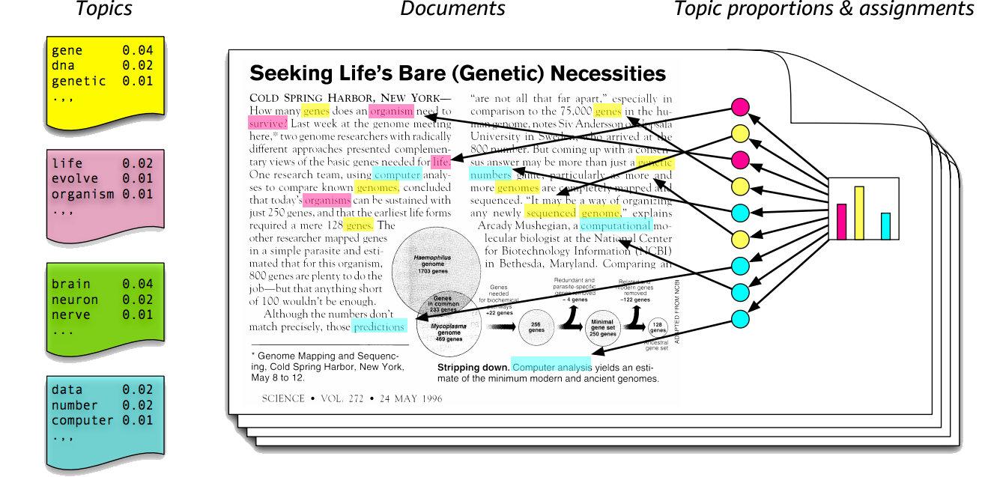
Topic Modeling
Probabilistic models for uncovering the underlying semantic structure of a document collection based on a hierarchical Bayesian analysis of the original texts
Topic models are algorithms for discovering the main themes that pervade a large and otherwise unstructured collection of documents. Topic models can organize the collection according to the discovered themes.

Slide 4
Latent Dirichlet Allocation (LDA)
In the LDA model, each document is viewed as a mixture of topics that are present in the corpus. The model proposes that each word in the document is attributable to one of the document’s topics
The idea behind LDA is to model documents as arising from multiple topics, where a topic is defined to be a distribution over a fixed vocabulary of terms
Given a dataset of documents, LDA backtracks and tries to figure out what topics would create those documents in the first place
http://www.cs.columbia.edu/~blei/papers/Blei2012.pdf
http://www.cs.columbia.edu/~blei/papers/BleiLafferty2009.pdf (sections 1 and 2)
https://en.wikipedia.org/wiki/Latent_Dirichlet_allocation

Slide 5
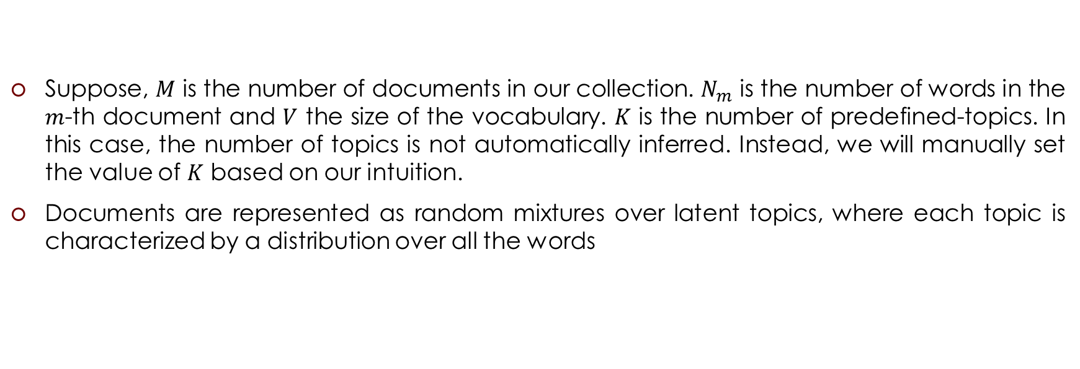
LDA: Generative Process
Suppose, $M$ is the number of documents in our collection. $N_{m}$ is the number of words in the $m$-th document and $V$ the size of the vocabulary. $K$ is the number of predefined-topics. In this case, the number of topics is not automatically inferred. Instead, we will manually set the value of $K$ based on our intuition.
Documents are represented as random mixtures over latent topics, where each topic is characterized by a distribution over all the words

Slide 6
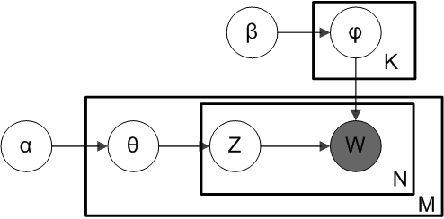
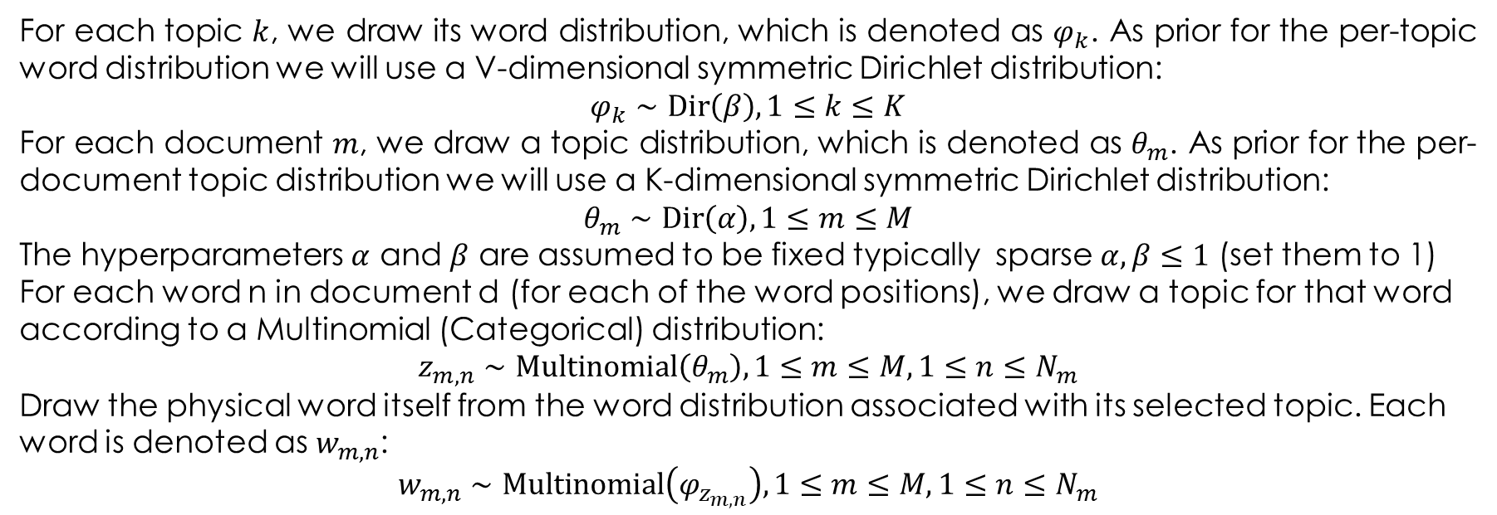
LDA: Generative Process
For each topic $k$, we draw its word distribution, which is denoted as $φ_{k}$. As prior for the per-topic word distribution we will use a V-dimensional symmetric Dirichlet distribution:
$$φ_{k}∼\text{Dir}\left(β\right), 1≤k≤K$$
For each document $m$, we draw a topic distribution, which is denoted as $θ_{m}$. As prior for the per-document topic distribution we will use a K-dimensional symmetric Dirichlet distribution:
$$θ_{m}∼\text{Dir}\left(α\right), 1≤m≤M$$
The hyperparameters $α$ and $β$ are assumed to be fixed typically sparse $α,β≤1$ (set them to 1)
For each word n in document d (for each of the word positions), we draw a topic for that word according to a Multinomial (Categorical) distribution:
$$z_{m,n}∼\text{Multinomial}\left(θ_{m}\right), 1≤m≤M, 1≤n≤N_{m}$$
Draw the physical word itself from the word distribution associated with its selected topic. Each word is denoted as $w_{m,n}$:
$$w_{m,n}∼\text{Multinomial}\left(φ_{z_{m,n}}\right), 1≤m≤M, 1≤n≤N_{m}$$

Slide 7
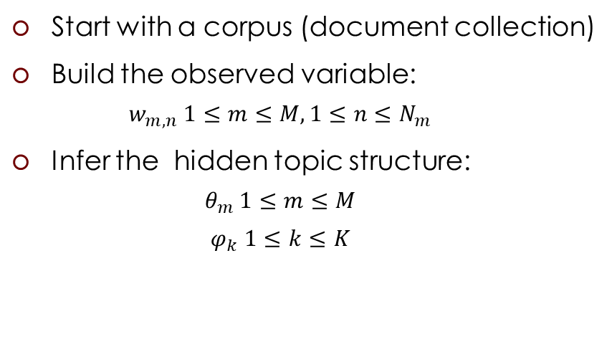
The Task
Document 1: I had a peanuts butter sandwich for breakfast.
Document 2: I like to eat almonds, peanuts and walnuts.
Document 3: My neighbor got a little dog yesterday.
Document 4: Cats and dogs are mortal enemies.
Document 5: You mustn’t feed peanuts to your dog.
[[0, 1, 2, 3, 4, 5, 6, 7]
[0, 8, 9, 10, 11, 3, 12, 13]
[14, 15, 16, 2, 17, 18, 19]
[20, 12, 21, 22, 23, 24]
[25, 26, 27, 3, 9, 28, 18]]
[[ 0.19633795 0.80366205]]
[[ 0.18370696 0.81629304]]
[[ 0.2242626 0.7757374]]
[[ 0.72682194 0.27317806]]
[[ 0.19720619 0.80279381]]
Start with a corpus (document collection)
Build the observed variable:
$$w_{m,n} 1≤m≤M, 1≤n≤N_{m}$$
Infer the hidden topic structure:
$$θ_{m} 1≤m≤M$$
$$φ_{k} 1≤k≤K$$
[[ 0.0153611 0.04258534 0.02096933 0.03742481 0.01003486 0.00337692
0.03687246 0.01759574 0.0308261 0.01290443 0.01975973 0.01656558
0.08359959 0.00988798 0.00815009 0.02573078 0.00934478 0.02543332
0.0267678 0.01700781 0.07986162 0.15302288 0.09572016 0.06718658
0.03541293 0.01084848 0.00399011 0.02285365 0.06090502]]
[[ 0.0475376 0.03045149 0.03110808 0.07166036 0.02985312 0.03845919
0.03310906 0.03910945 0.05759958 0.0438841 0.0596612 0.02342716
0.03582313 0.02156961 0.03489024 0.01348096 0.00848053 0.04888085
0.03665115 0.02932311 0.02411743 0.01016715 0.02278155 0.04463838
0.00023452 0.05109875 0.03079135 0.04895514 0.03225578]]

Slide 8
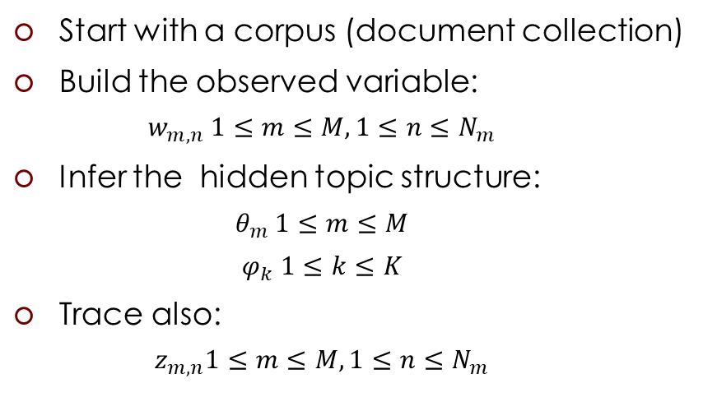
Sanity Check
docs = [["aaa", "bbb", "aaa"],
["bbb", "aaa", "bbb"],
["aaa", "bbb", "bbb", "aaa"],
["uuu", "vvv"],
["uuu", "vvv", "vvv"],
["uuu", "vvv", "vvv", "uuu"]]
[[0, 1, 0] [1, 0, 1] [0, 1, 1, 0] [2, 3] [2, 3, 3] [2, 3, 3, 2]]
[[ 0.56363964 0.43636036]]
[[ 0.3713786 0.6286214]]
[[ 0.96678627 0.03321373]]
[[ 0.04743652 0.95256348]]
[[ 0.26409289 0.73590711]]
[[ 0.24063087 0.75936913]]
Start with a corpus (document collection)
Build the observed variable:
$$w_{m,n} 1≤m≤M, 1≤n≤N_{m}$$
Infer the hidden topic structure:
$$θ_{m} 1≤m≤M$$
$$φ_{k} 1≤k≤K$$
Trace also:
$$z_{m,n}1≤m≤M, 1≤n≤N_{m}$$
[[ 0.49718579 0.33963714 0.08627236 0.07690471]]
[[ 0.02396443 0.10446209 0.5212554 0.35031808]]
[0 0 0]
[0 0 0]
[0 0 0 0]
[1 1]
[1 1 1]
[1 1 1 1]

Slide 9
Extras
Can the topic model be used to define a topic-based similarity measure between documents? (0.5)
What about a new document? How can topics be assigned to it? (0.75)
Extensions:
The correlated topic model (1.5)
The dynamic topic model (1.5)

